Slide 1
Ruby/Ruby on Rails
Introduction & Ruby Basic
Vu Xuan Dung @Framgia

Slide 2
Schedule
Introduction
Ruby Basic
Ruby Advance
Ruby on Rails (1)
Ruby on Rails (2)
…..
Ruby on Rails (11)
Project

Slide 3
Ruby Introduction

Slide 4
Ruby introduction(1)
- Creater by Matsumoto Yukihiro ( Matz)
first version was releases in 1995
- Ruby inspired from Perl and some other languages
- Ruby is Opensource, big open community. especially in USA and Japan
- Ruby lastest version : 2.1

Slide 5
Ruby introduction(2)
- Ruby also is a scripting language
ex: if you are not familiar with shell (in unix) or batch (in windows) , Ruby is good choice
- Web framework written by Ruby : Ruby on Rails
- Famous service in the world using Ruby as their backbone : Twitter, Github, Basecamp, Cookpad, SlideShare

Slide 6
Ruby certificate
Ruby Silver/Gold
Framgia VietNam has 5 member hold Ruby silver
➡ first company outside Japan has Ruby Association Certified System Integrator Silver

Slide 7
Ruby Feature
- Pure OOP (Object Oriented Programming)
- Class Base (vs prototype-based language as javascript)
- Dynamic language
- Reflection
Notes:
Ví dụ chi tiết từng đặc tính chính của Ruby

Slide 8
Why we love Ruby
in C
int main(void){
int t;
for(i = 0; i < 10; i++)
printf(“I love you.”);
return 0;
}
in Ruby
10.times{ print ‘I love you’ }
So Cool

Slide 9
Let Practice

Slide 10
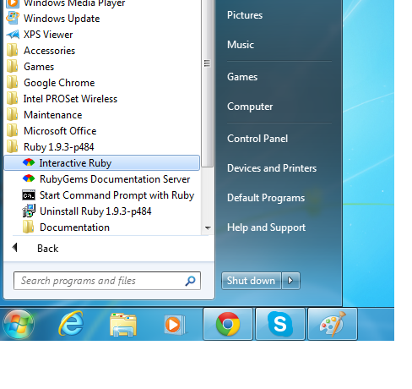
Install Ruby
if you are using Linux/MacOS
, Ruby is default installed
if using windows please install
rubyinstaller in the USB

Slide 11
Ruby command
$ ruby -v
ruby 1.9.3p448 (2013-06-27 revision 41675) [x86_64-darwin12.4.0]
$ ruby -e "puts 'Hello World' "
Hello World
$ruby hello.rb
Hello World

Slide 12
Class and method
#comment define class
class Hoge
# define method
def method1
puts “HogeHoge”
end
end

Slide 13
Create object from class
# create instance
instance = Hoge.new
# call method
instance.method1

Slide 14
Number
puts 1+2 # 3
puts 1.0 + 2.0 # 3.0
puts 2.0 * 3.0 # 6.0
puts 5.0 - 8.0 # -3.0
puts 9.0 / 2.0 # 4.5

Slide 15
Question(1)
Please answer result of below calculation
puts 9/2
puts 9.0/2.0
puts 5/2.0
puts 2**4
puts 0.4 - 0.3 == 0.1

Slide 16
String
planet = “Earth”
puts “Hello” + “ “ + planet # “Hello Earth”
s = “hello”
puts s[0] # “h”
puts s[0,2] # “he”
puts s[0..2] # “hel”

Slide 17
Question(2)
Please answer results
s = “hello”
puts s[-3..-1]
puts s[0..0]
puts s[2..1]
puts s[7..10]

Slide 18
Arrays
[1,2,3]
[[1,2],[3,4],[5]]
a = [0,1,2,3,4]
puts a[0] # 0
puts a[-1] # 4
puts a[0..2] # [0,1,2]

Slide 19
Arrays
a = []
a << 1 # [1]
a << [2,3] # [1,2,3]
a + [4,5] # [1,2,3,4,5]
a + [[6,7]] # [1,2,3,[6,7]]
[‘a’,’b’,’c’,’b’,’a’] - [‘b’,’c’,’d’] # [‘a’,’a’]

Slide 20
Question(3)
Please answer results
a = [0,1,4,9,16]
puts a[-2]
puts a[-2,-1]
puts a[0,0]
puts a + [25, 30]

Slide 21
Hashes
numbers = Hash.new
numbers[“one”] = 1
numbers[“two”] = 2
numbers = { “one” => 1, “two” => 2 }
numbers = { one: 1, two: 2 }

Slide 22
Question(4)
Please answer results
numbers = { “one” => 1, “two” => 2 }
puts numbers[“one”] + numbers[“two”]

Slide 23
Study source
The ruby programing language
Ruby metaprograming

Slide 24
Progress
the ruby programming language
chapter 1, chapter 2, and first half of chapter 3
is completed

